Slide 1
ChadaTech Agile
Transitioning to Scrum-Agile
Carla Nemley
Southern New Hampshire University
CS-250 Software Development
Deron Dantzler
22 February 2026

Slide 2
Introduction
This presentation explores ChadaTech’s move to a Scrum-Agile methodology, focusing on adapting workflows to enhance flexibility, collaboration, and efficiency. We will provide an overview of Agile roles and the Software Development Lifecycle phases within this framework. Emphasis is placed on modern development practices that support continuous improvement and faster deliveries in a highly dynamic environment.

Slide 3
01
Agile Transition Overview

Slide 4

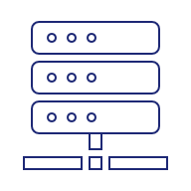


Scrum-Agile Roles
Scrum Master
Removes impediments, coaches the team on Agile practices, and ensures the Scrum process is followed effectively.
Product Owner
Defines user stories, manages the product backlog, and maximizes the value of the of the product delivered.
Developers
Cross-functional team members who design, build, and integrate features during each sprint.
Tester (QA)
Ensures quality by validating functionality, identifying bugs, and verifying that acceptance criteria are met.
Each role collaborates to ensure transparent communication and rapid adaptation throughout the sprint cycle.

Slide 5






SDLC Phases in Agile
Agile redefines the SDLC by evolving requirements into user stories that adapt over time. Development happens incrementally, with design and implementation closely integrated. Continuous testing ensures quality at every step, while frequent deployments provide quick user feedback. Regular retrospectives help teams refine processes and improve outcomes, embracing change rather than resisting it. This dynamic approach supports iterative delivery and ongoing improvement.
Requirements
Design & Dev
Testing
Deployment
Retrospectives
Evolving user stories & backlog refinement
Incremental design & coding sprints
Continuous integration & QA checks
Frequent releases & reviews
Team reflection & improvement

Slide 6

Key Takeaways
Transparency
ChadaTechs Agile transition emphasizes transparency, enabling clear visibility of progress across all teams. The focus on iterative development promotes flexibility and adaptability in delivering value. Continuous backlog refinement ensures priorities align with business needs, while ongoing testing and retrospectives drive quality and process improvement. This approach supports sustainable growth and effective response to change.
Open visibility into project status for all stakeholders
Iterative Development
Delivering functional increments in short, repeated cycles.
Backlog Refinement
Constant prioritization to ensure high-value features are built first.
Continuous Testing
Integrating QA early to reduce technical debt and bugs.
Retrospectives
Team-driven reviews to adapt and improve processes.

Slide 7
02
Comparing Agile and Waterfall

Slide 8









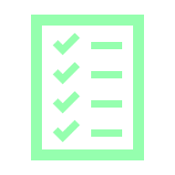


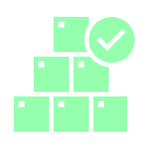
How Waterfall Would Differ
The Waterfall model follows a linear and sequential approach with clearly defined phases and fixed requirements. Testing occurs only at the end, increasing risk of late defect discovery. Changes after requirements are locked often cause delays and costly redesigns. Waterfall’s structure suits projects with well-understood scope but lacks agility for dynamic environments like software development.
Linear & Sequential
Iterative & Incremental
Stages must complete before next begins
Delivers value in small, usable chunks
Fixed Requirements
Adaptive Scope
Scope defined upfront; rigid structure
SPRINT
CYCLE
Welcomes changing requirements
Late Testing
Continuous Testing
QA happens at the end; bugs are costly
QA integrated throughout development
Feature changes would require full redesign & significant delays
New features integrated & deployed in next sprint cycle

Slide 9
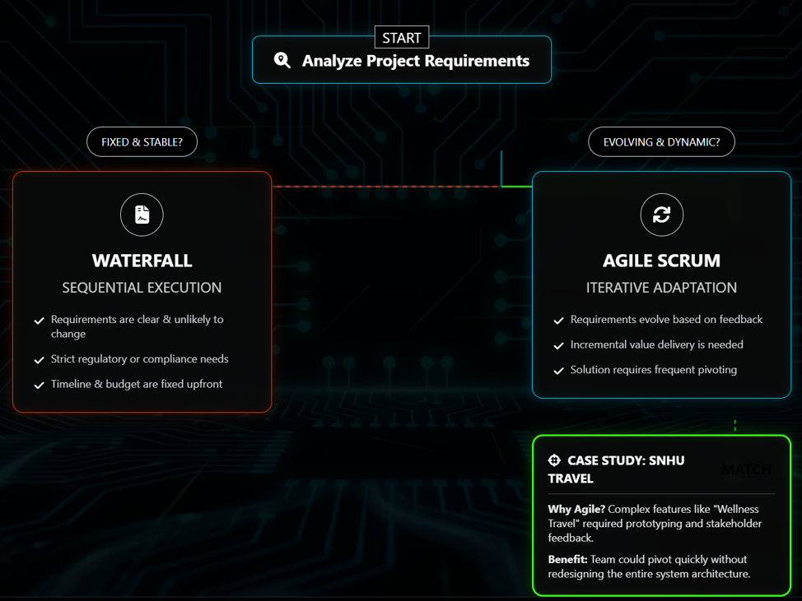
Choosing Waterfall vs. Agile
Waterfall works best for projects with stable, unchanging requirements and predictable outcomes. Agile excels when requirements are uncertain or evolving, enabling frequent feedback and continuous delivery. For the SNHU Travel project, Agile’s flexibility was critical to accommodate ongoing changes and stakeholder input, ensuring higher responsiveness and product alignment with user needs.
Agile is ideal for projects requiring rapid adaptation, continuous delivery, and close collaboration. Waterfall suits highly regulated or infrastructure projects demanding rigorous documentation and fixed schedules. Choosing depends on project complexity, stakeholder involvement, and tolerance for change. Organizations benefit from selecting the methodology that best fits their objectives and environment.

Slide 10
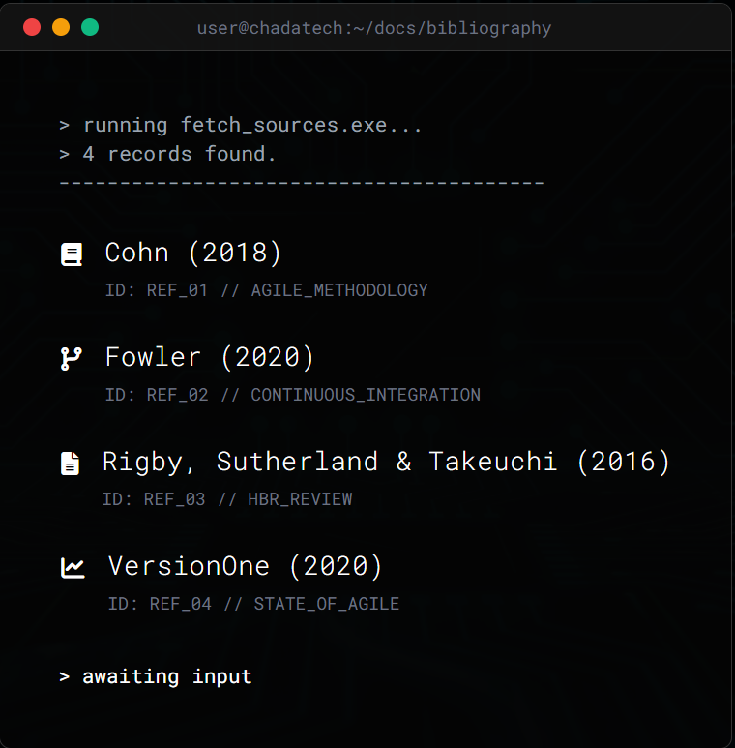
REFERENCES

Slide 11

Conclusions
Adopting the Scrum-Agile approach positions ChadaTech to respond swiftly to market demands with greater team collaboration and transparency. By embracing iterative development, continuous testing, and regular retrospectives, the company fosters a culture of continuous improvement. Understanding when to leverage Agile or Waterfall empowers better project outcomes and strategic alignment with business goals.

